Slide 1
ONE NATION ,ONE ELECTION AND ITS IMPLICATIONS FOR INDIA’S FEDERAL STRUCTURE
The journey of ‘oneness’ has been a long one- One Nation, One Tax, One Nation One Ration Card and the latest addition is One Nation, One Election (ONOE)

Slide 2
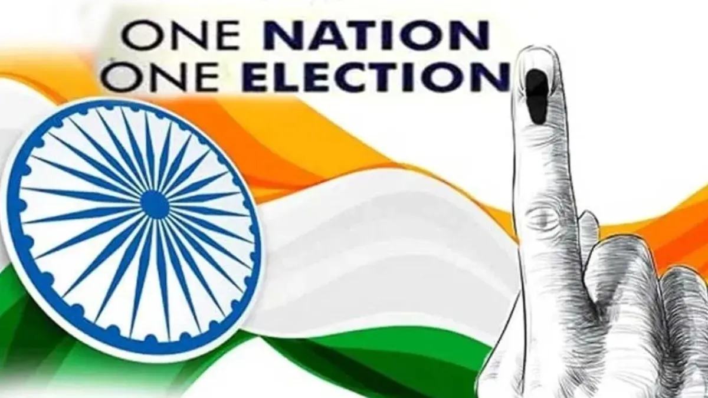

Slide 3
Introduction
India’s democratic framework thrives on the vibrancy of its electoral process, enabling citizens to actively shape governance at every level. Since independence, over 400 elections to the Lok Sabha and State Legislative Assemblies have showcased the Election Commission of India's commitment to fairness and transparency. However, the fragmented and frequent nature of elections has sparked discussions on the need for a more efficient system. This has led to the resurgence of interest in the concept of “One Nation, One Election.”

Slide 4
ONOE -IDEA
On September 2, 2023, the government formed an eight- member high level committee headed by former President Mr. Ram Nath Kovind to examine the legal and procedural feasibility of simultaneous elections.

Slide 5
OVERVIEW
One Nation, One Election is a proposal under consideration by the Government of India to synchronise all elections in the country either on a single day or within a specific time frame, with an objective of cutting election cost. One of its most notable proposals is to simultaneously conduct elections to the Lok Sabha and state legislative assemblies of all the states and the union territories. The Bill was introduced in Indian Parliament’s Lower House i.e., Lok Sabha on 17th December 2024

Slide 6
JPC MEMBERS
The Lok Sabha on approved a 39 member joint parliamentary committee(JPC) to examine The Constitution ( one hundred and twenty-Ninth Amendment ) Bill 2024 and the amendments to the Government of Union Territories Act, 1963, the twin bills that aim to usher in simultaneous state and national elections.
The panel, earlier planned for 31 members, will now have 39 members after some smaller parties met Lok Sabha Speaker Mr. Om Birla and demanded their inclusion in the important committee. There are 27 Lok Sabha MPs and 12 Rajya Sabha lawmakers in it.

Slide 7
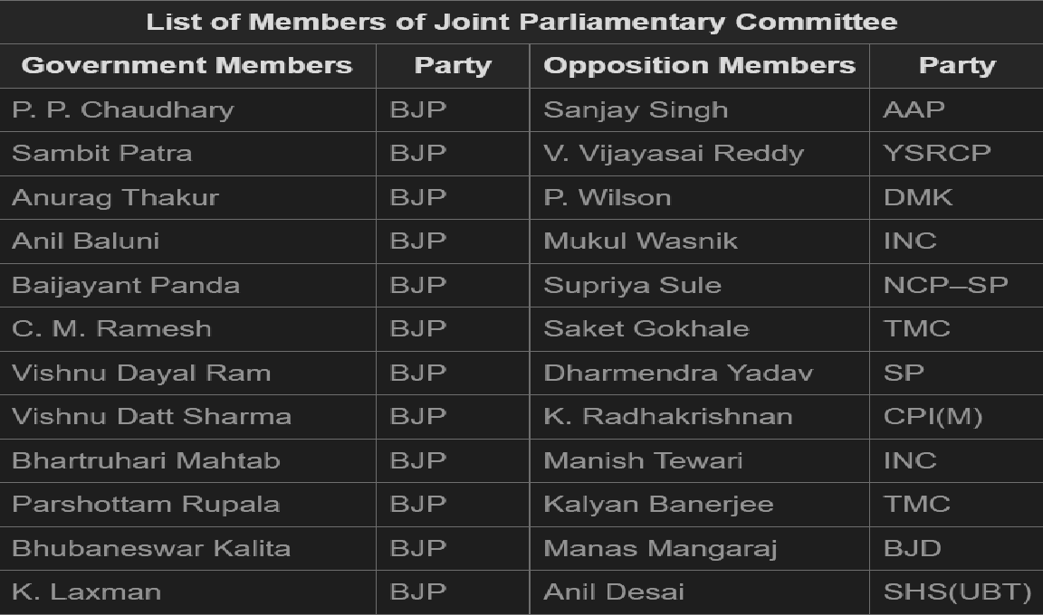

Slide 8
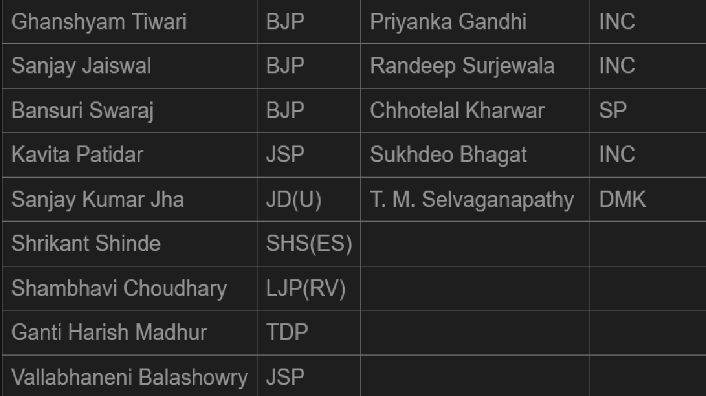

Slide 9
CURTAILING THE POWER OF STATES
According to Article 174, the power to prorogue or dissolve a state assembly vests with the governor who acts after he receives a request from the chief minister. In the case of synchronised elections, the state assemblies will also have a fixed term. Will the CMs have the authority to dissolve state assemblies within the term, after ONOE is implemented? If the states lose this provision, the prerogative of dissolving an assembly will go to the PM, which will violate the basic principle of federalism, explains Balveer Arora, the author of India’s Beleaguered Federalism:

Slide 10
UNDERMINING REGIONAL ISSUES
Experts believe that ONOE may lead to regional issues getting undermined as national parties will ride on the back of national achievement to garner political support even at the state level

Slide 11
IMPACT ON REGIONAL PARTIES
Research shows people tend to vote for bigger parties if elections are held simultaneously.

Slide 12
REPRESENTATIVE
While federalism, as experts note, may end up becoming the biggest casualty of ONOE, question arises why the Mr Kovind – led committee lacks state representation. If the government is initiating a process that is fundamentally going to change the dynamics of elections for regional and state level parties, it is within the norm of cooperative federalism that states be represented in the decision making committee.

Slide 13
ONOE
ONOE promises cost- efficiency and policy continuity. But can India, with its 1.4 billion people and countless political identities , be made to vote in a single voice, at a single time?

Slide 14
REFERENCES
1. India Today
2. The Hindu.
3. Press Information Bureau.
4. BBC.
5. Study IQ Education.
6. Outlook India.
7.Google.
8. The Economic and Political Weekly
9. Frontline

Slide 15
RUPAK SINHA
ASSOCIATE PROFESSOR,
JANATA COLLEGE ,
Serfanguri,
BTR, KOKRAJHAR, ASSAM
THANK YOU VERY MUCH

